Slide 1


AVIATION CAREER DAY
Palm Beach International Airport
Palm Beach County Department of Airports
September 24, 2025

Slide 2
Department of Airports
Department of Palm Beach County
More than 150 Employees
Divisions
  Administration
  Planning & Development
  Properties
  Fiscal
  Maintenance (Terminal/Grounds)
  Airport Operations (Operations, Security Office, Communication Center and Training)

Slide 3
Airport Security Office
Responsible for the ID badging process in accordance with TSA Regulations
    Verification of Identification Documents
    Fingerprinting
    Background Checks
    Badge Issuance/Renewals
    Ramp Decals
    Records
    Auditing of ID Media
Ramp Decals
Lost and Found

Slide 4
Airport Communication Center
Responsible for the Emergency/Non-Emergency
Dispatching at PBI
  Airport Operations
  Airport Maintenance
  Various Contractors
Coordination with Outside Agencies and Tenants for Emergency/Non-Emergencies
  PBSO
  PBC CFR/ARFF
  PBC Emergency Mgt.
Field calls from the general public on a variety of topics
Monitor systems and coordinates response (Fire Alarm)
Monitor Security Access Control and Alarms

Slide 5
Training
Responsible for Training Airport Security and
Driver Training to tenants/employees/contractors
  Initial/Advanced Security Training
  Non-Movement Area Driver Training (Ramp)
  Movement Area Driver Training (Runways/Taxiways)
Tracks PBC-required training for DOA employees
Assigns and tracks specialized training for DOA employees
Delivers specialized training to tenants
Responsible for training curriculum and presentations

Slide 6
Airport Operations
Airside Operations – responsible for day-to day operations on the movement/non-movement areas (runways/taxiways/ramps)
Landside Operations – responsible for day-to-day operations of landside areas (airport roadways, parking, ground transportation)
Terminal Operations – responsible for day-to-day operations of Terminal (airlines, concessions, public areas)

Slide 7
Airside Operations
Examples of daily tasks
  Conduct airfield safety inspections (daily, periodic, special, and continuous)
  Respond to emergencies (aircraft, airfield, fuel spills, etc.)
  Responsible for airfield safety, FAA compliance (Advisory Circulars/FAR Part 139, Other FARs)
  Responsible for airport security (TSA, Security Regulations)
  Oversee construction (coordination, airfield closures, etc)
  Coordinate with FAA ATCT
  Coordinate with governmental entities (Federal, State and Local)
  Perform aircraft escorts

Slide 8
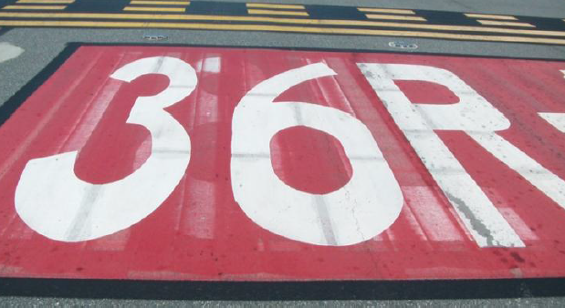
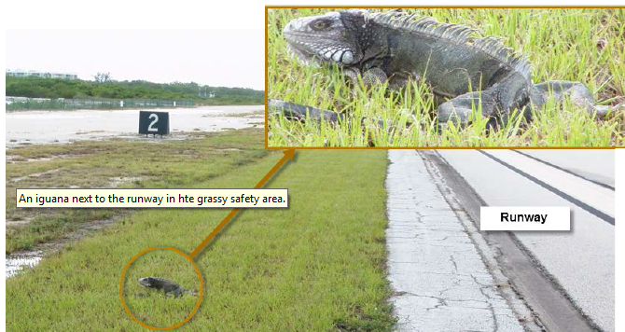
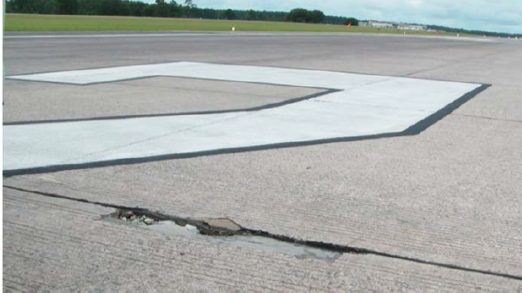
Airport Inspections
Airfield Safety Self Inspections – Categories
  Pavement Areas
  Safety Areas
  Markings
  Signs Lighting
  Navaids
  Obstructions
  Fueling
  Snow and Ice
  Construction
  Airport Rescue and Fire Fighting (ARFF)
  Public protection
  Wildlife

Slide 9
Terminal Operations
Examples of daily tasks
  Conduct Safety Inspections in the Terminal
  Respond to emergencies (fires, evacuations, medical)
  Responsible for airport security (TSA, Security Regulations, door alarms/suspicious items or people)
  Coordinate construction (Gate closures)
  Coordinate with tenants (FBOs, Concessions, etc.)
  Coordinate with governmental entities (Federal, State and Local)
  Plan/conduct emergency readiness meetings & exercises
  Respond to facilities related issues (i.e. power loss, fire alarms)
  Represent Department at public meetings & events
  Maintain regulatory documents (ACM, ASP, AEP)

Slide 10
Landside Operations
Examples of daily tasks
  Perform inspections of roadways/curbside areas
  Inspection of parking facilities
  Inspections of ancillary properties
  Coordinate construction in landside areas (i.e. parking garage)
  Coordinate with DOA Maintenance andcontractors (i.e. parking contractor)

Slide 11
Airport Security
Commercial Airport
PBI Airport Security Plan (ASP) – describes how the Airport will meet the requirements of FAR Part 1542/SDs
TSA Regulations/Directives & Coordination
Tenant Monitoring/Testing
Training – SIDA /Non-Movement Area/Movement Area
Perimeter Inspections
Enhanced Inspections – vehicles/personnel
Coordination with Law Enforcement (PBSO)
Inspections of employees with access to certain areas
Emergency Exercises/Meetings

Slide 12
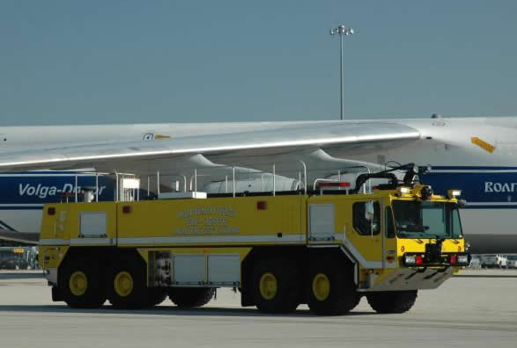
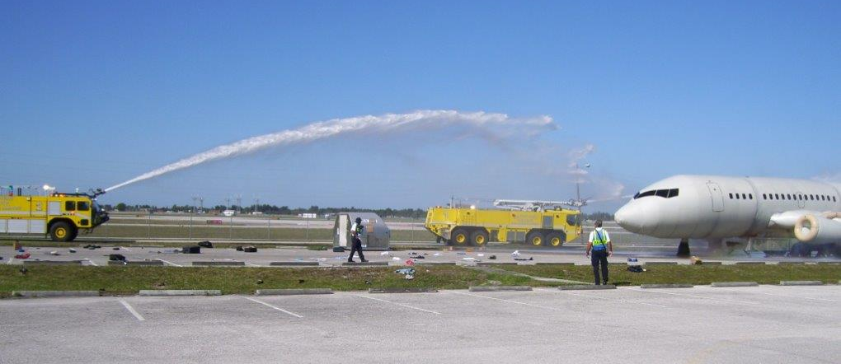
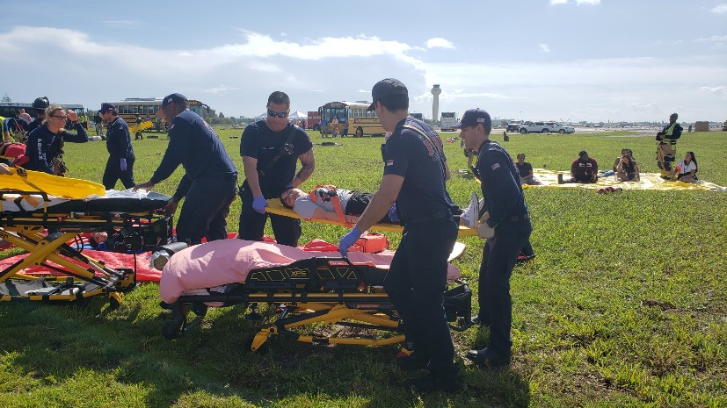
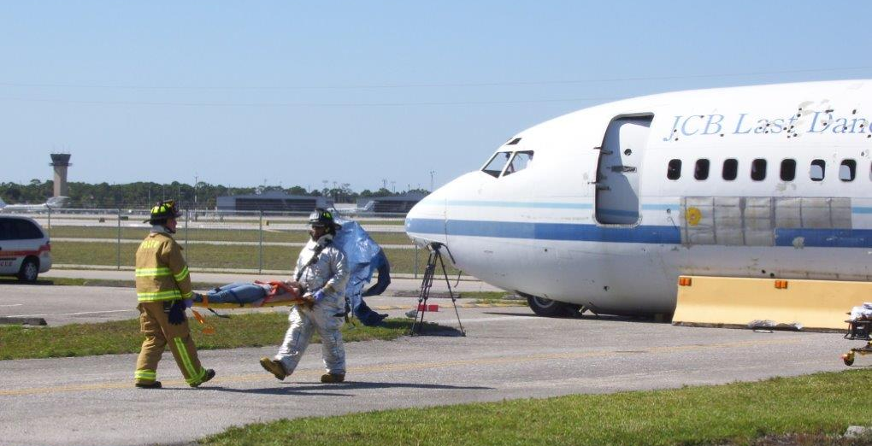
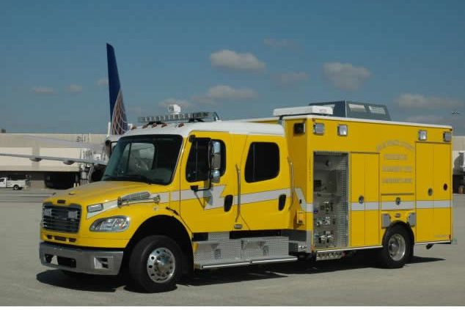
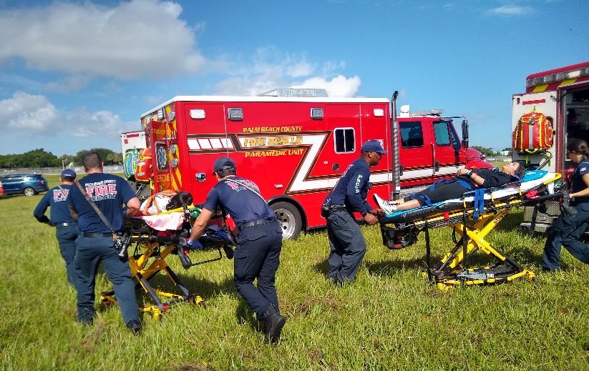
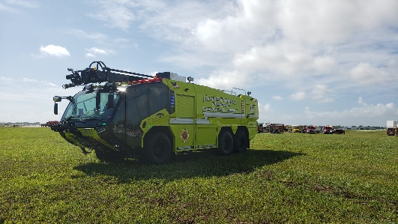
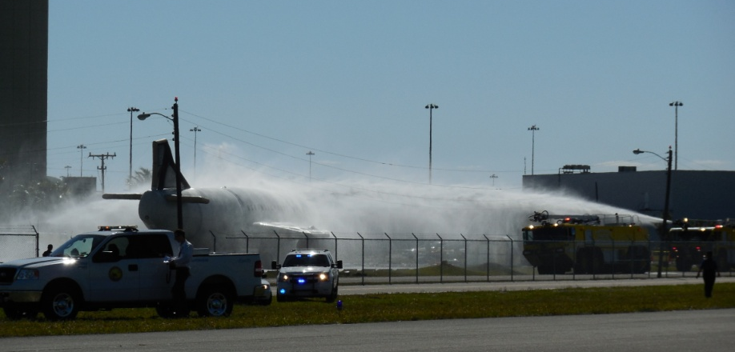
Airport Rescue and Fire Fighting (ARFF)/EMERGENCY EXERCISES

Slide 13
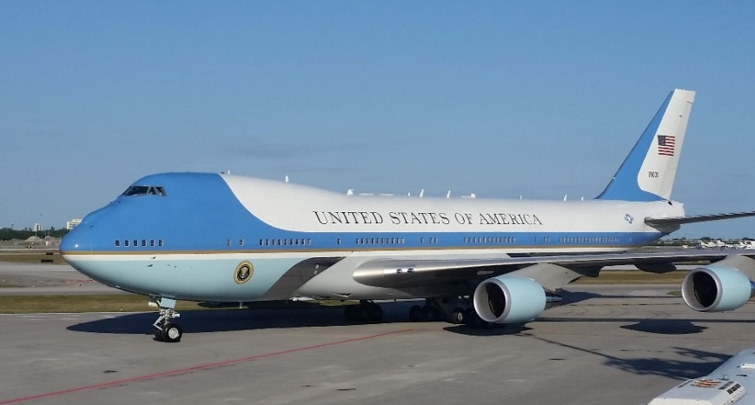
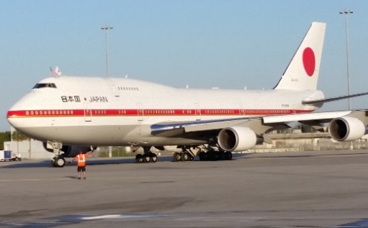
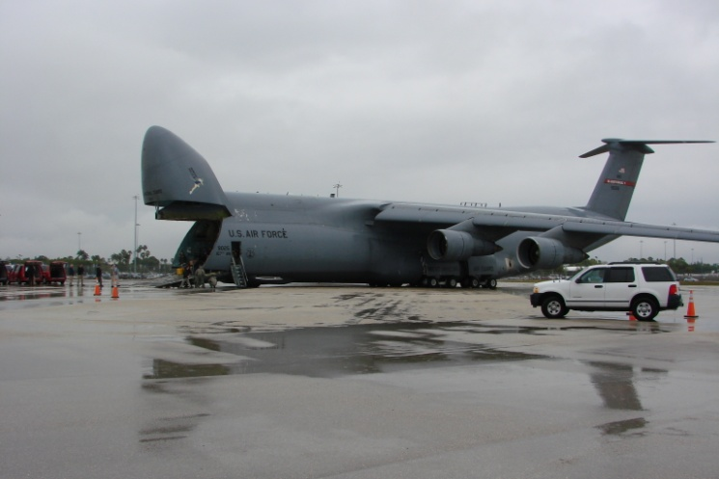
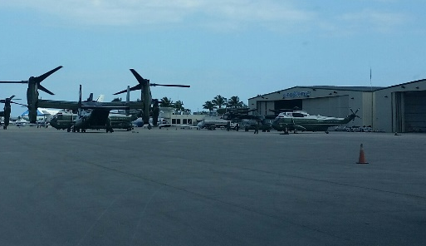
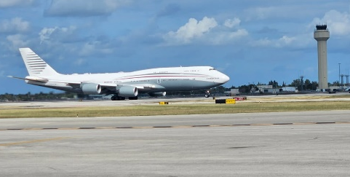
Governmental Coordination
Locally – County Depts.
FDOT – projects, regulations, inspections
Federal
      Air Traffic Control (FAA)
      Navaid Repairs (FAA)
      Security (FBI)
      VIPs (US Secret Service, Military, Foreign Governments/Representatives)
      Customs and Border Protection (International Flights, Diverts)
      Special Events (FIFA 2025, Boca Raton Bowl, Cognizant Classic)

