Slide 1
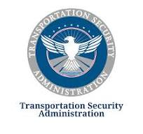
Palm Beach International Airport
TSA History & Mission Statement
TSA Pay Scale 2025: Updated Salary & Benefits Guide
A Comprehensive Overview for Prospective TSA Recruits

Slide 2
Why Join the TSA?
Structured salary system aligned with the federal General Schedule (GS).
Competitive salaries with locality pay adjustments.
Opportunities for career growth, step increases, and comprehensive benefits.
TSA Mission Statement
Mission: Protect the nation’s transportation systems to ensure freedom of movement for people and commerce.
TSA focuses on safeguarding air travel, railways, highways, and mass transit systems against threats.
Brief History of TSA
The Transportation Security Administration (TSA) was established in 2001 following the tragic events of September 11, 2001.
Created under the Aviation and Transportation Security Act, TSA was tasked with securing the nation’s transportation systems.
Initially part of the Department of Transportation, TSA transitioned to the Department of Homeland Security (DHS) in 2003.

Slide 3
Jobs available within the Domestic Aviation Operations (DAO)
Security Operations
Management and Leadership
Transportation Security Officer (STSO, LTSO,TSO): Frontline personnel responsible for screening passengers, baggage, and cargo at airports.
Coordination Center Officer (CCO): Monitors security operations and coordinates responses to incidents.
Instructor/Trainer: Provides training for TSA personnel on security procedures, equipment, and protocols.
TSA Canine Handler: Works with trained dogs to detect explosives and other threats in transportation environments.
TSA Inspector: Ensures compliance with TSA regulations and policies at transportation hubs to maintain security standards.
TSA Explosives Detection Specialist: Operates and maintains explosives detection systems to identify and mitigate potential threats.
Federal Air Marshal (FAM): Provides in-flight security by detecting, deterring, and responding to threats to ensure the safety of passengers and crew.
Federal Security Director (FSD): Senior leadership role responsible for managing TSA operations at airports.
Federal Security Director Group (DFSD,AFSD DAFSDs): Supports the FSD in overseeing airport security programs.
Transportation Security Manager (STSM,TSM): Supervises STSO,LTSO and TSOs and oversees airport security operations.

Slide 4
Training for New TSOs
Basic Training Program:
New TSOs undergo basic training to learn the skills and knowledge required for passenger and baggage screening.
Training includes classroom instruction, hands-on practice, and simulations.
Federal Law Enforcement Training Center (FLETC):
New TSOs attend training at the FLETC TSA Academy located in Glynco, Georgia.
FLETC is the primary training facility for TSA personnel and other federal law enforcement officers.
On-the-Job Training:
After completing classroom training at FLETC, new TSOs receive on-the-job training at their assigned airport

Slide 5
TSA Salaries in 2025 and Comprehensive Benefits Package
Salary
Starting salary for TSO (Band D, Step 1): $34,454 base plus 24.67% South Florida locality (Miami to Port St. Lucie) .
Step increases (1-10): Every 1–3 years depending on step level.
Step Progression Timeline:
Steps 1 → 2 → 3 → 4: each after 1 year
Steps 4 → 5 → 6 → 7: every 2 years
Steps 7 → 8 → 9 → 10: every 3 year
Benefits
Health insurance through the Federal Employees Health Benefits (FEHB) program.
Retirement coverage under the Federal Employees Retirement System (FERS), including pension and Social Security.
Thrift Savings Plan (TSP) with government matching contributions, similar to a 401(k).
Paid leave including annual leave, sick leave, and federal holidays.
Life and disability insurance options through FEGLI.
Career development opportunities, such as training programs and promotion potential.

Slide 6

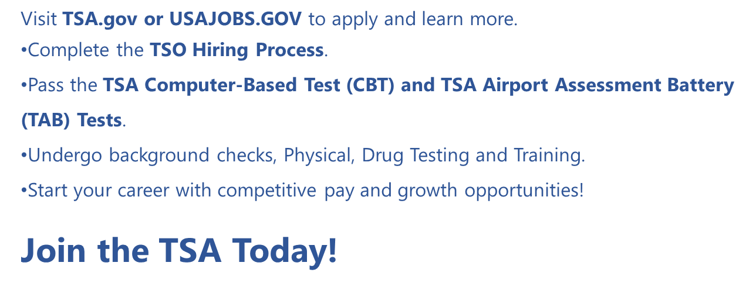
TSA Base Salaries in 2025, continue
Steps to Become a TSA Officer

