Slide 1

What is an Engineer?
An Engineer is a person who design, builds, or maintains engines, machines, or public works. (from Oxford Languages)
There are many types of Engineering including:
Civil, Structural, Transportation, Environmental, Mechanical, Aerospace, Marine, Automotive, Electrical, Computer, Chemical, Industrial
Civil engineers work on infrastructure projects, such as the design and construction of airports, bridges, water and sewage treatment plants, roads and streets, tunnels and other critical systems that our society needs to operate. (from National University)

Slide 2




How do you become an engineer?
To become a licensed Professional Engineer in Florida, you must meet criteria in the three (3) following areas (from Florida Board of Professional Engineers):
Education
Bachelor of Science degree in engineering from an EAC/ABET-accredited program;
Examinations
Pass the Fundamentals of Engineering (FE) exam; and
Pass the Principles & Practice of Engineering (PE) exam
Experience
Verified, progressive engineering experience working under a licensed PE:
Four (4) years if you have a B.S. in engineering

Slide 3
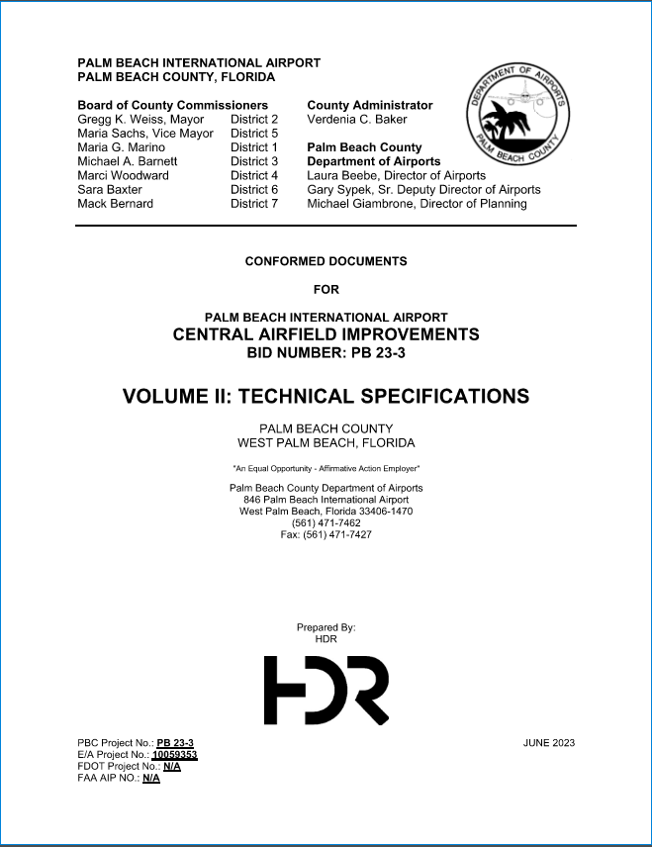
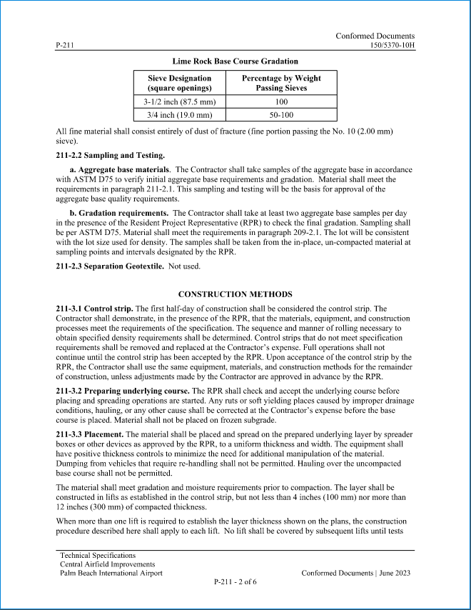
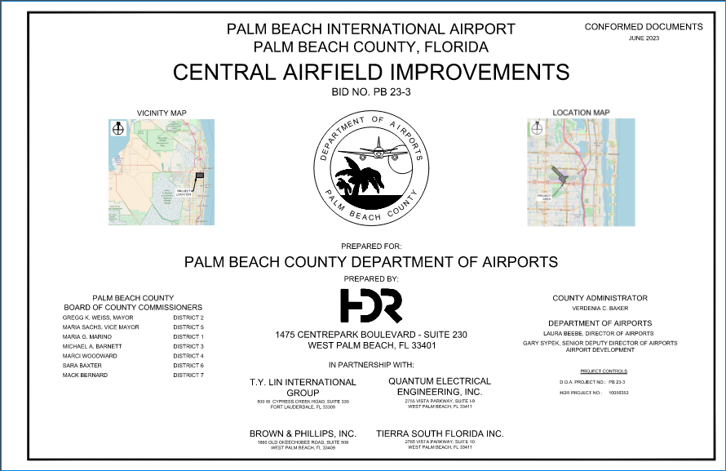
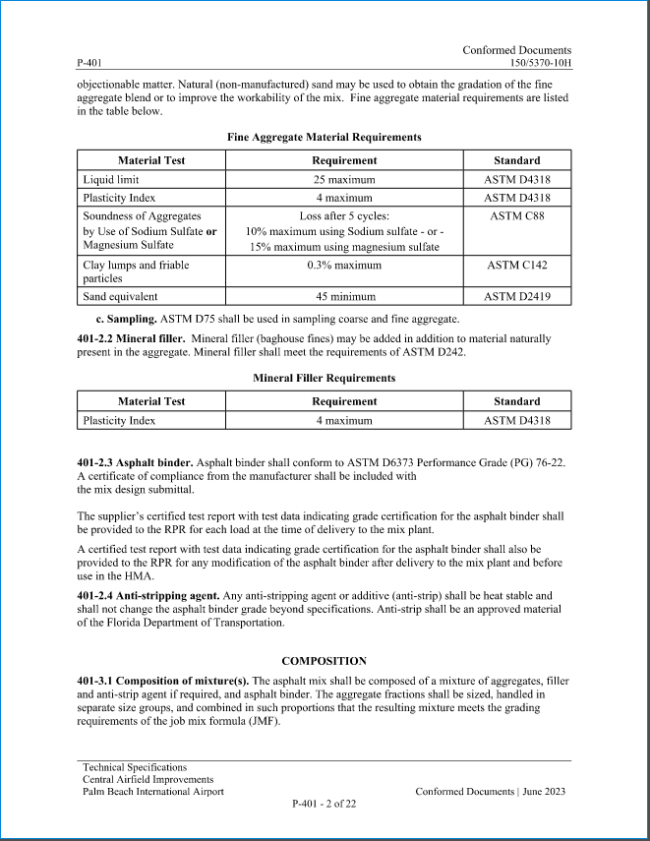
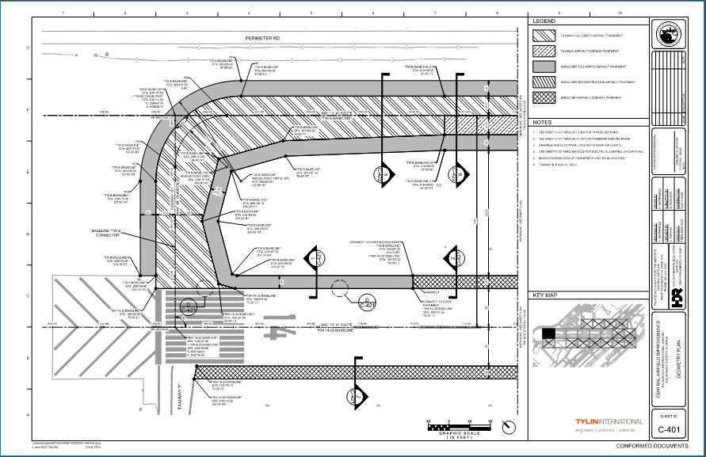
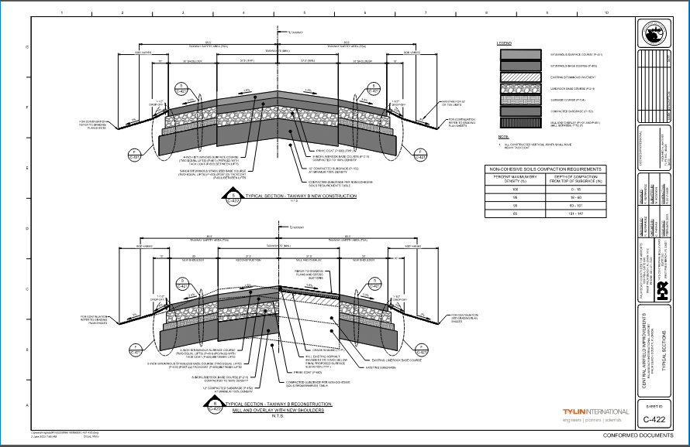
What do you do on a daily basis?
A problem/improvement is identified.
Data Collection
Review of Existing Record Drawings, Previous Permits, etc.
Field Investigation
Might include: Survey, Geotechnical, Utility Locates, etc.
Design gets developed based on above.
Construction Documents
Drawings, Project Manual, Engineers Report
Based on Specifications: FDOT, FAA, Florida Building Code, etc.

Slide 4
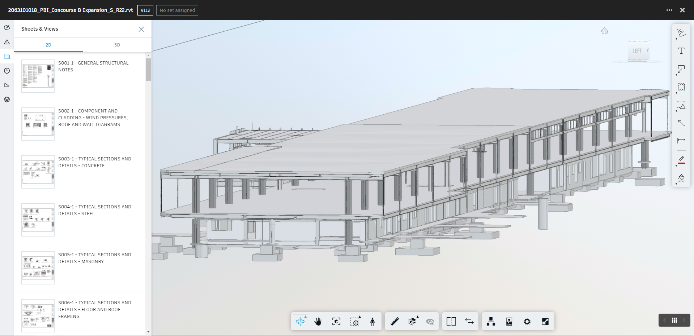

What do you do on a daily basis?
Bidding
Advertise Construction Project; meeting Local/State/Federal Requirements
Pre-Bid Meeting with Contractors, Site Visit
Respond to Contractor questions (RFI)
Execute contract to lowest, responsible/responsive Contractor
Construction
Project Management
Construction Management
Inspections

Slide 5
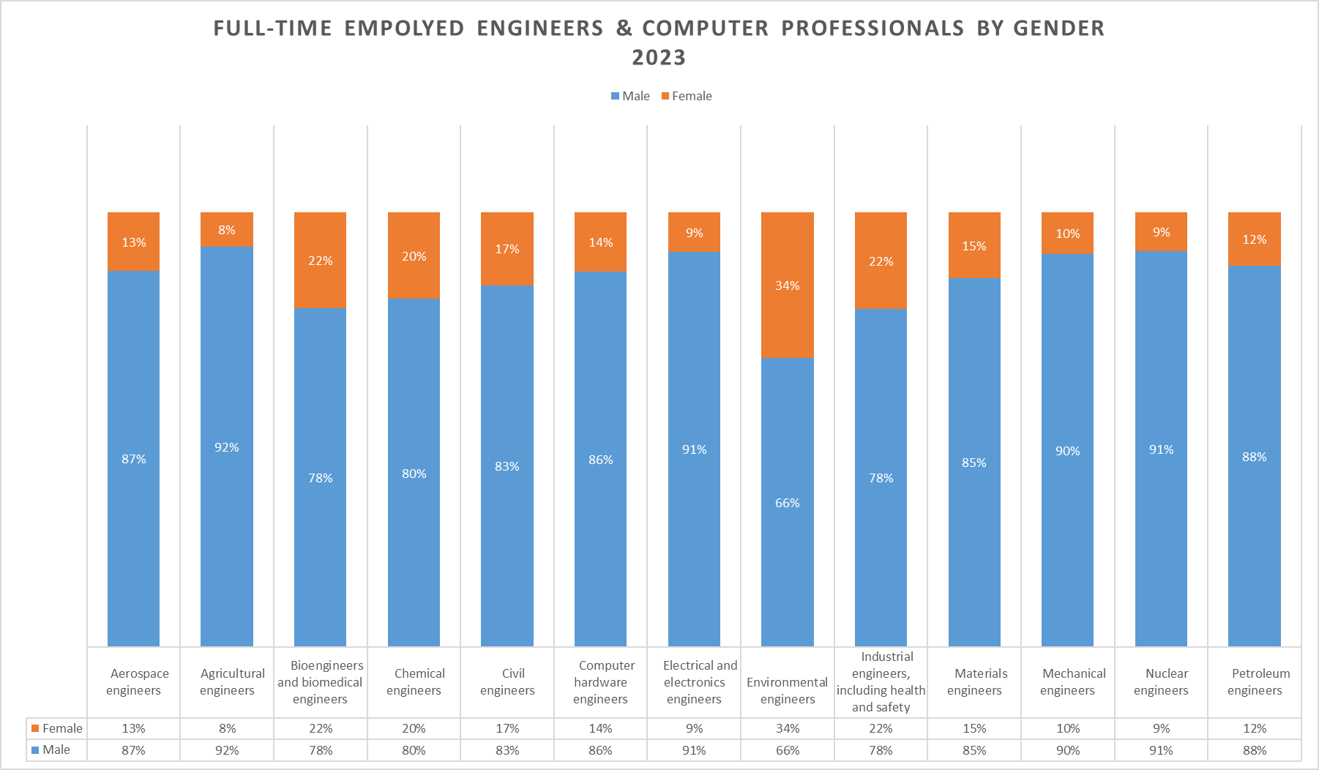
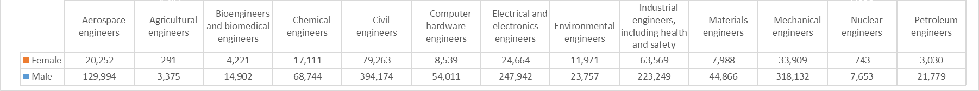
Any advice for women interested in engineering?
Source: U.S Census Bureau. Detailed occupation for the civilian employed population 16 years and over. Tables B24115 and B24116. https://data.census.gov/
Notes:
Slide for Cindy

Slide 6
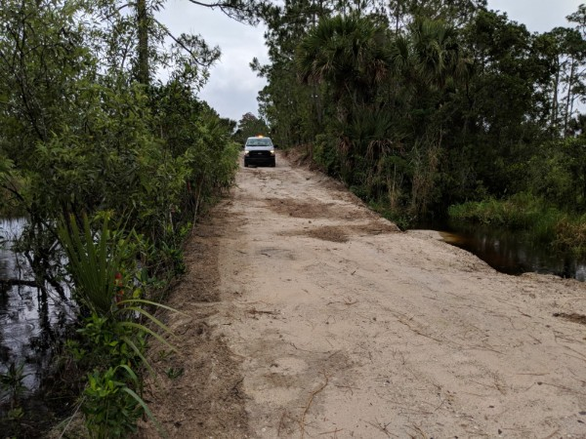
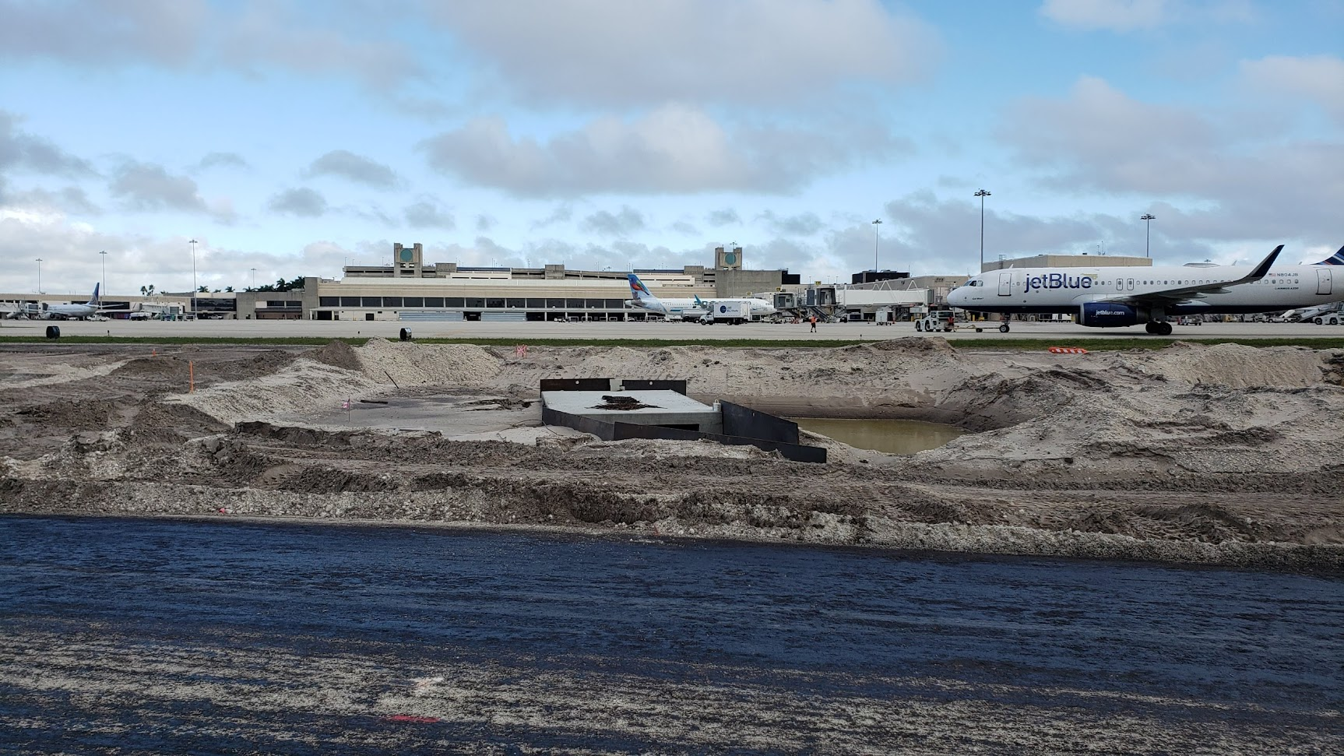
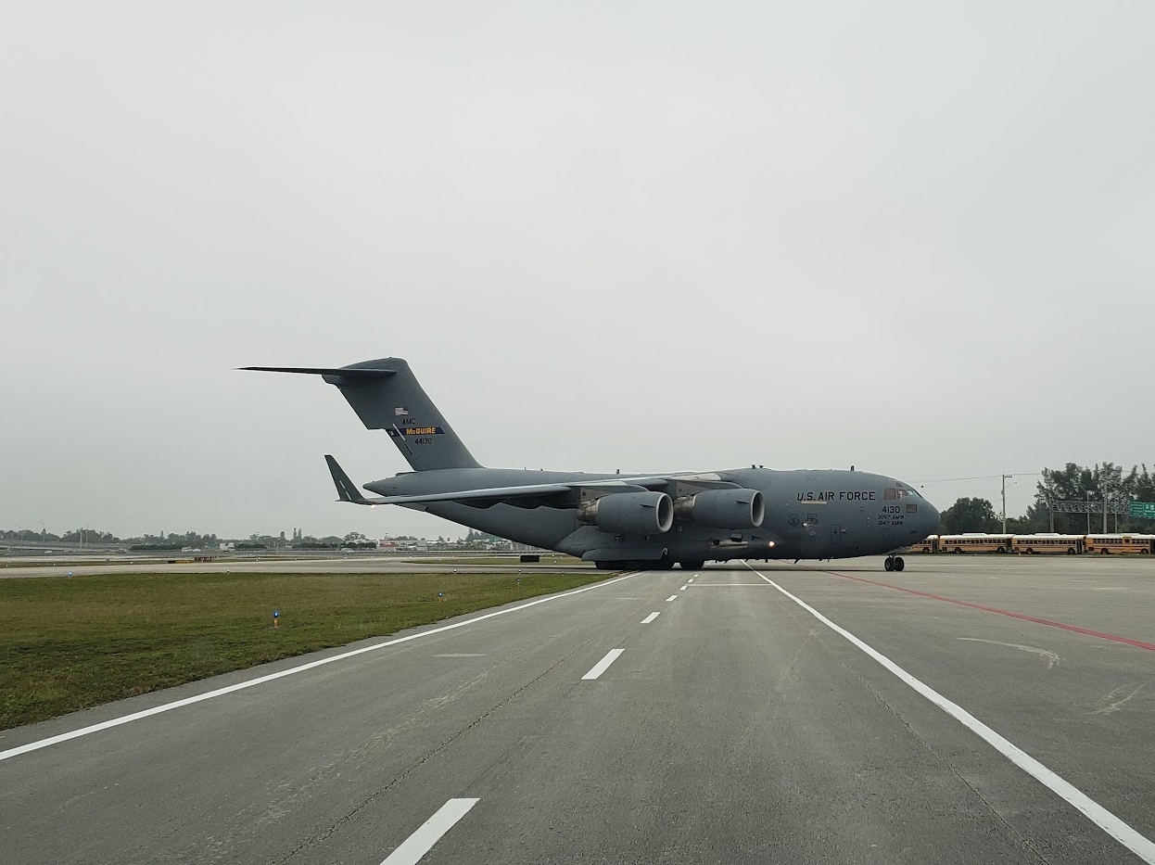
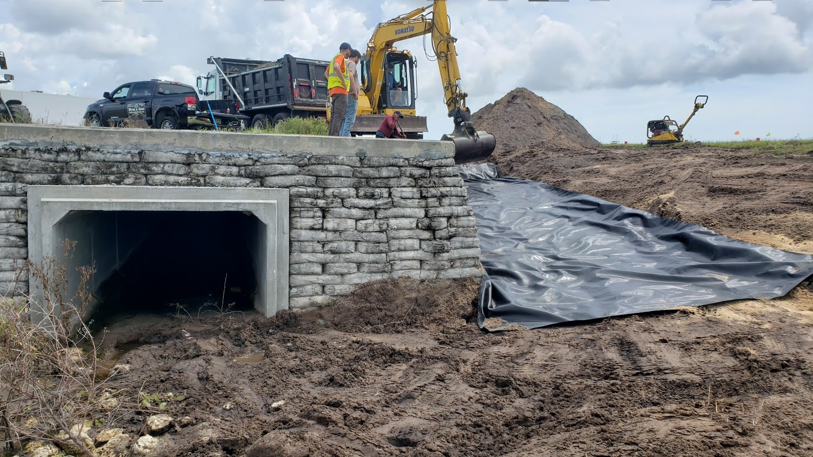
How much does it cost to operate an airport?
It cost $128,703,469 to operate the four (4) airports under the Department of Airports (FY 2024)
Includes Operating (ongoing expenses) and Capital (new projects) costs

Slide 7
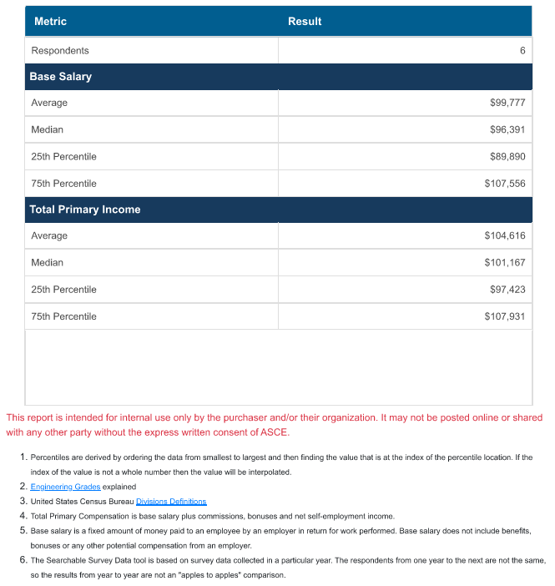
What is the average pay per year for an engineer?
Licenses or Certification: Professional Engineers (PE) License
Years of Experience: 3 to 10 years
Metropolitan Area: Miami FL
Total Primary Compensation is Base Salary plus commissions, bonuses, and net self-employment income.
Base salary is fixed amount paid to an employee by an employer. Base salary does not included benefits, bonuses from an employer.
(from American Society of Civil Engineers)

Slide 8

Do you offer internships?
The Department of Airports offers paid engineering internships.
Interns will assist in administering Airport design, planning and construction contracts.
Requires strong written and communications skills and ability to work independently and meet deadlines.
AutoCAD, Excel, Bluebeam Revu
Intern must be enrolled as a student in an accredited schooling program, university or college.
Check the County website for openings:
https://secure.co.palm-beach.fl.us/OnlineJobs/

Slide 9
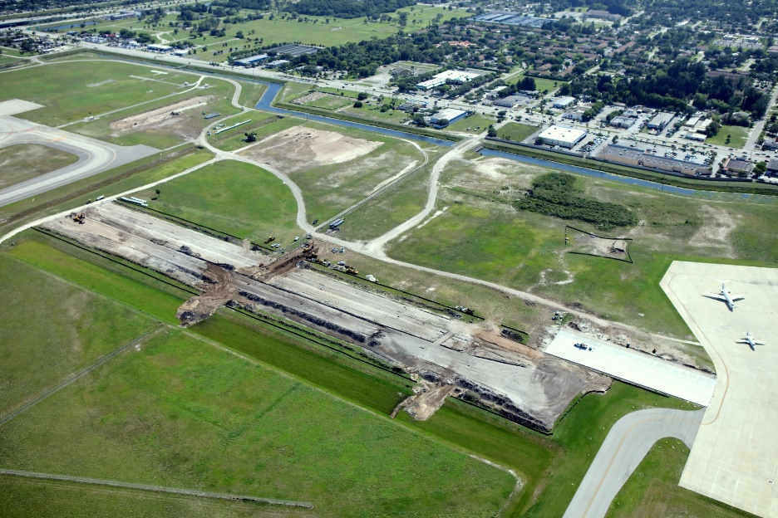
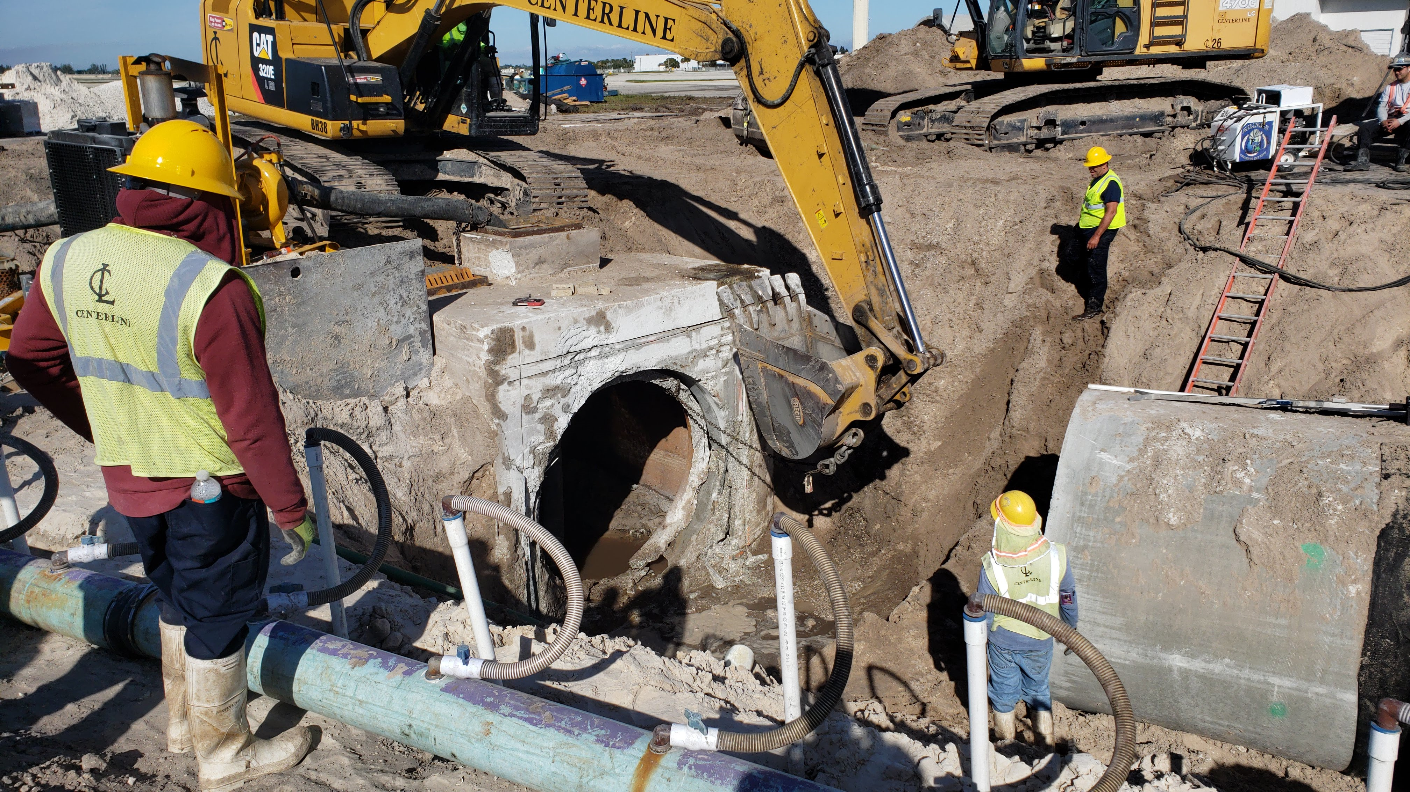
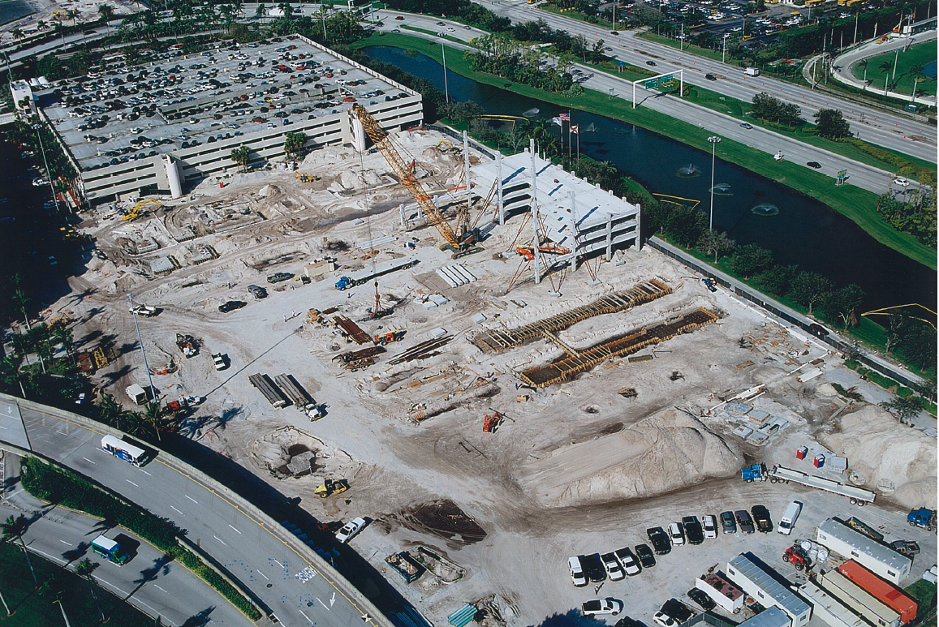

Past & Current Projects
Northeast Airfield Improvements at PBI
Civil & Electrical
Construction of Taxiway W at PBI
Civil & Electrical
Central Airfield Improvements at PBI
Civil & Electrical
Long-Term Parking Garage No. 3 at PBI
Civil, Electrical, Structural, Mechanical & Architectural

Slide 10
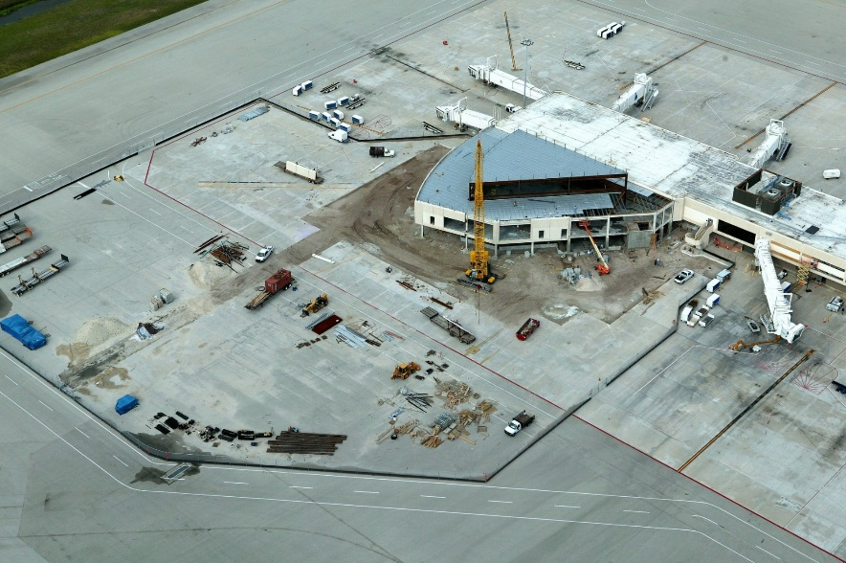
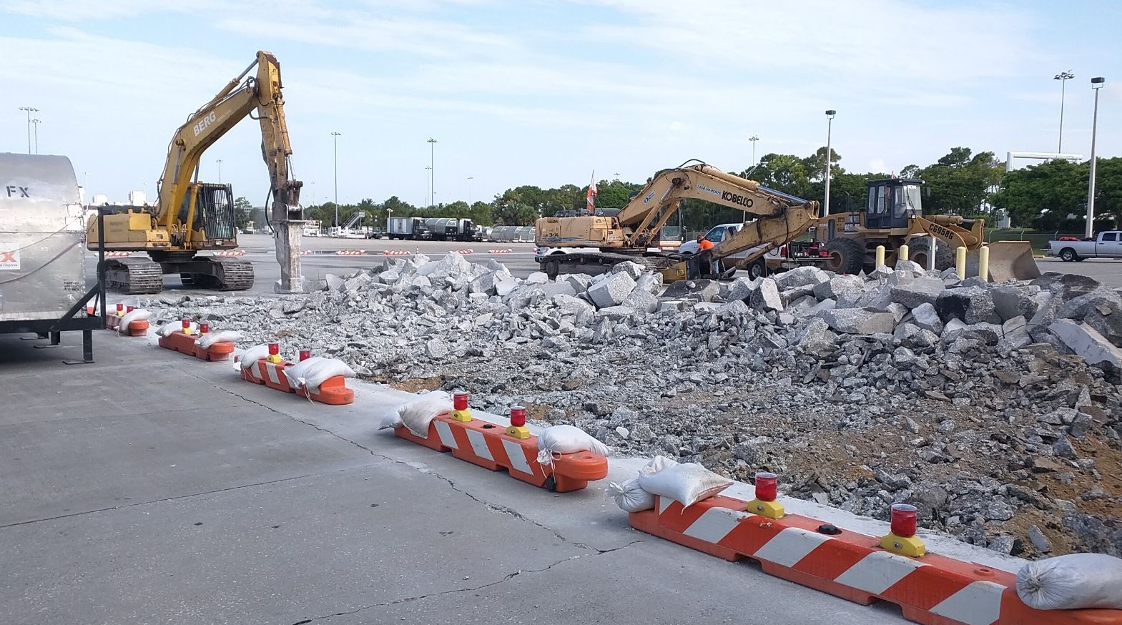
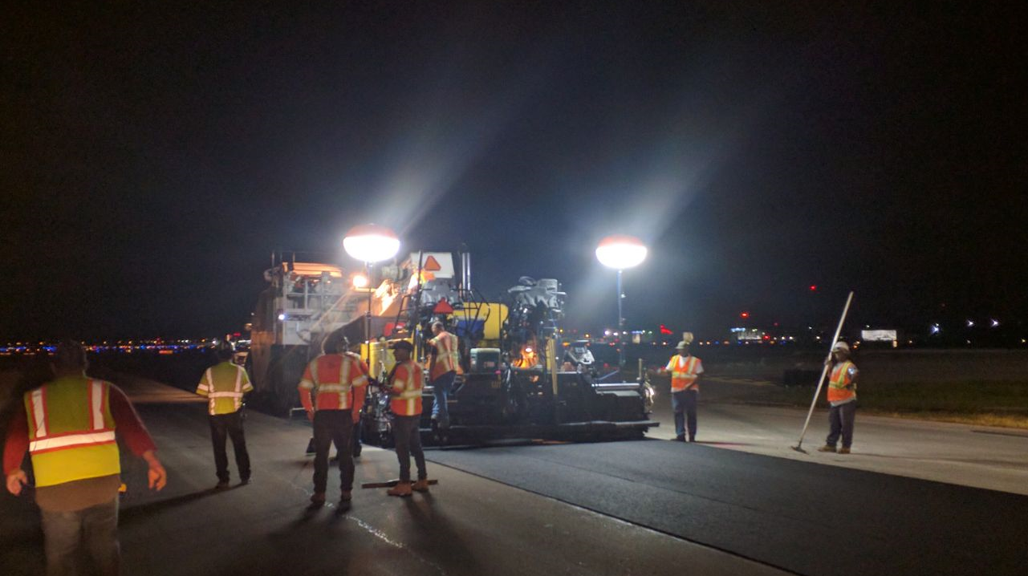
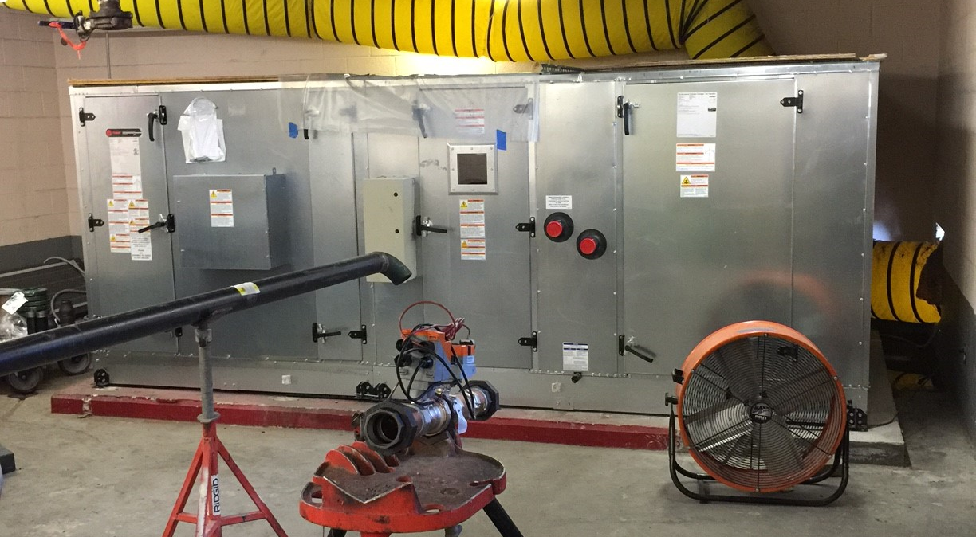
Past & Current Projects
Concourse C Expansion at PBI
Civil, Electrical, Structural, Mechanical & Architectural
Air Cargo Rehabilitation at PBI
Civil & Electrical
Taxiway C Rehabilitation at PBI
Civil & Electrical
Air Handler Replacement Phase 1 & 2 at PBI
Mechanical & Electrical

