Slide 1
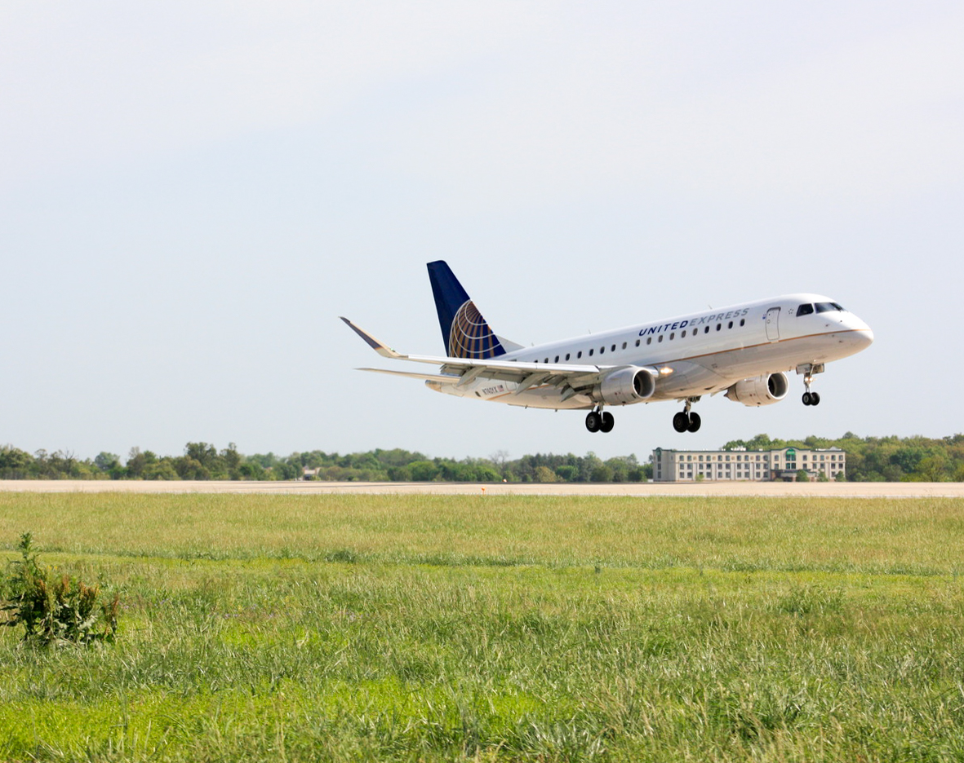



PBI Careers In Aviation Day
ENGINEERING

Slide 2

What do you think we do?

Slide 3
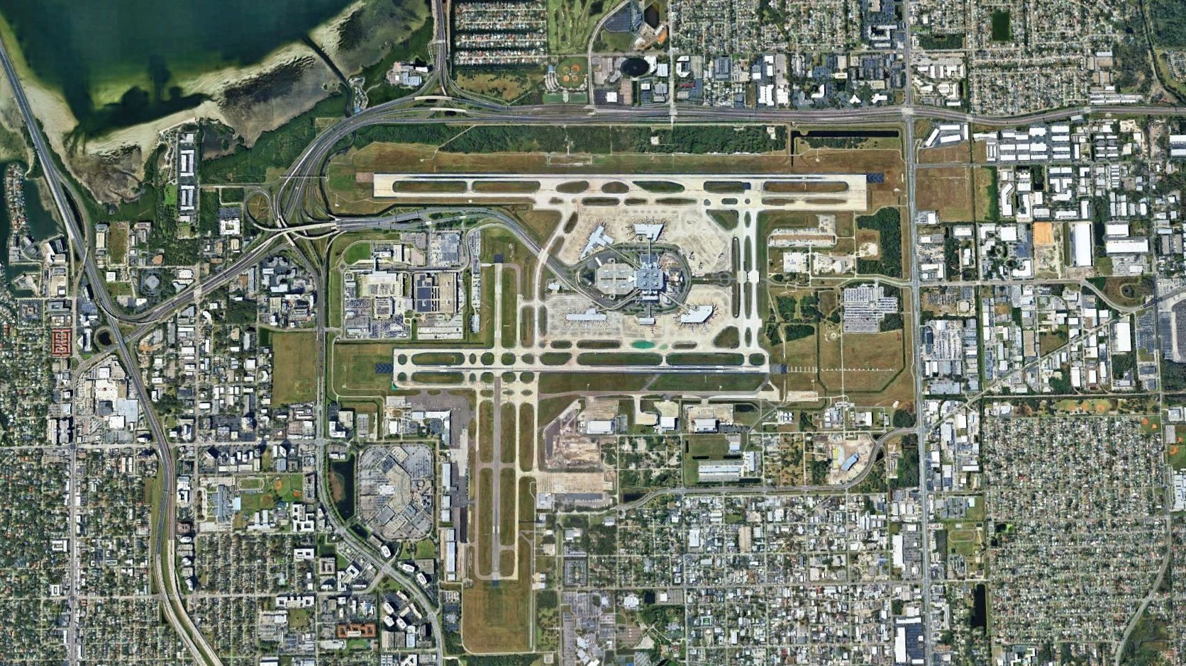
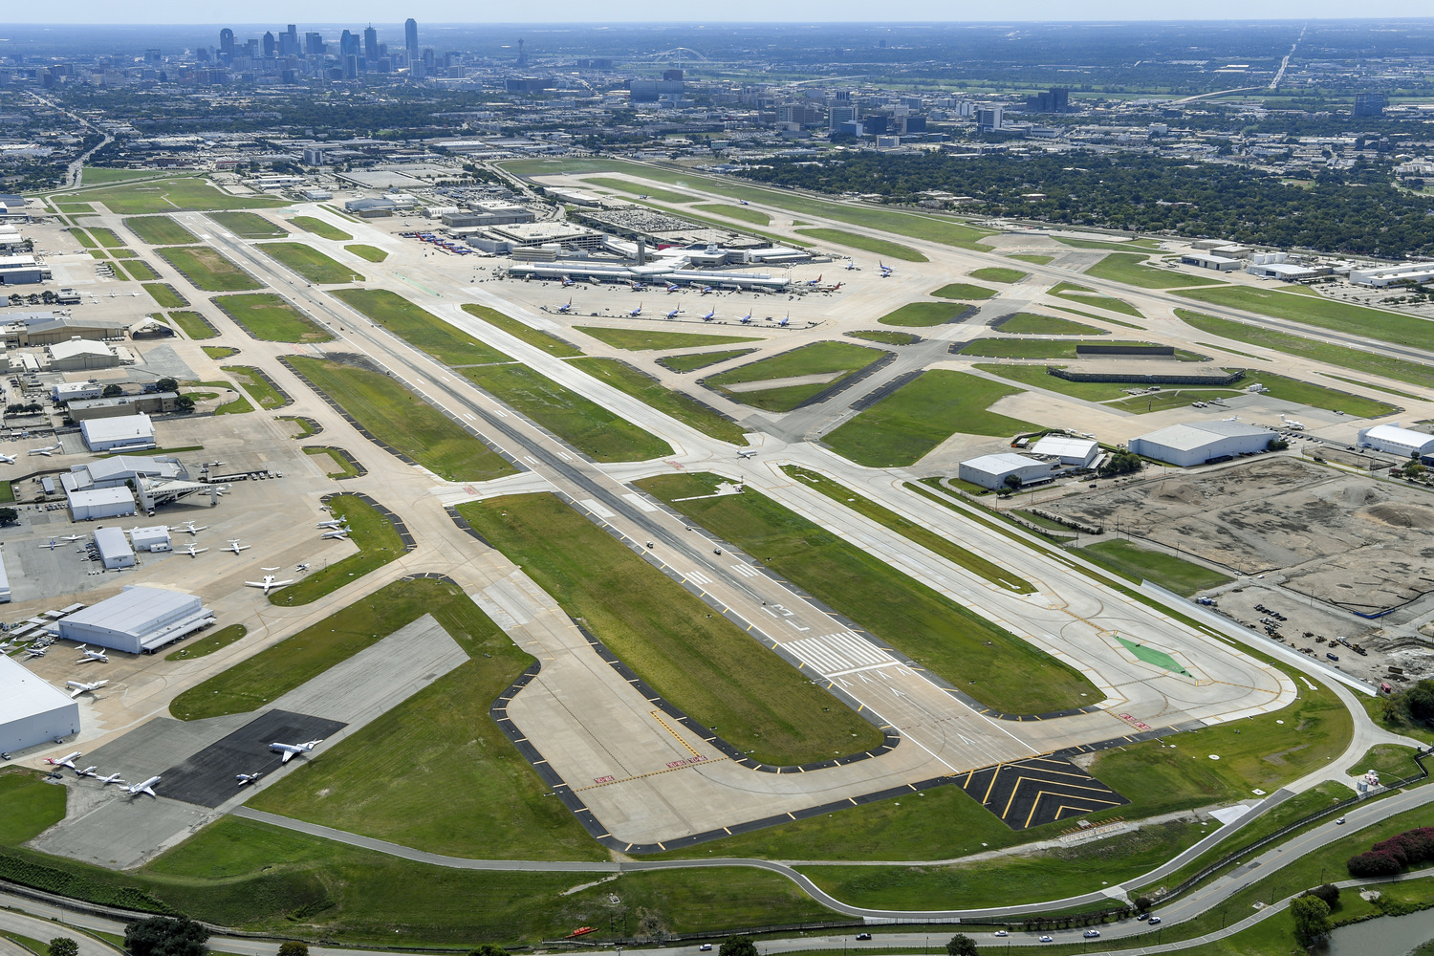
AVIATION DESIGN
Airfields

Slide 4
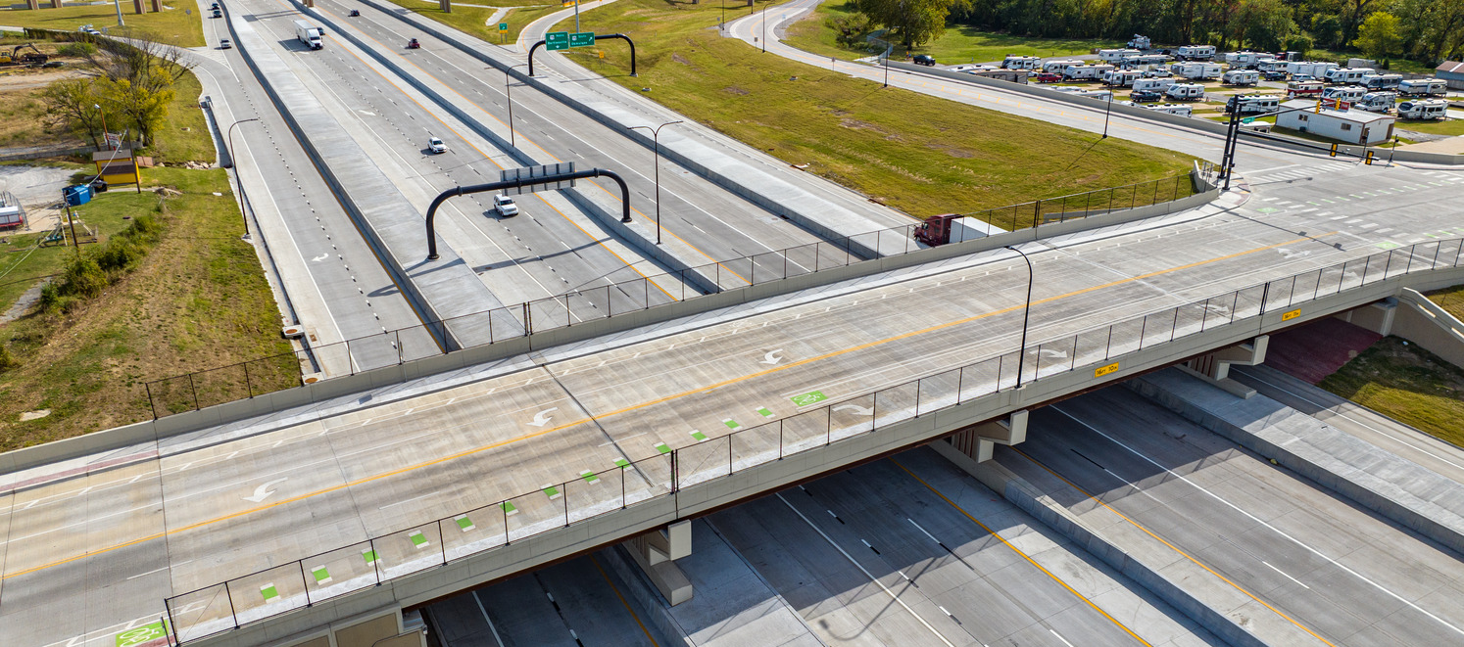
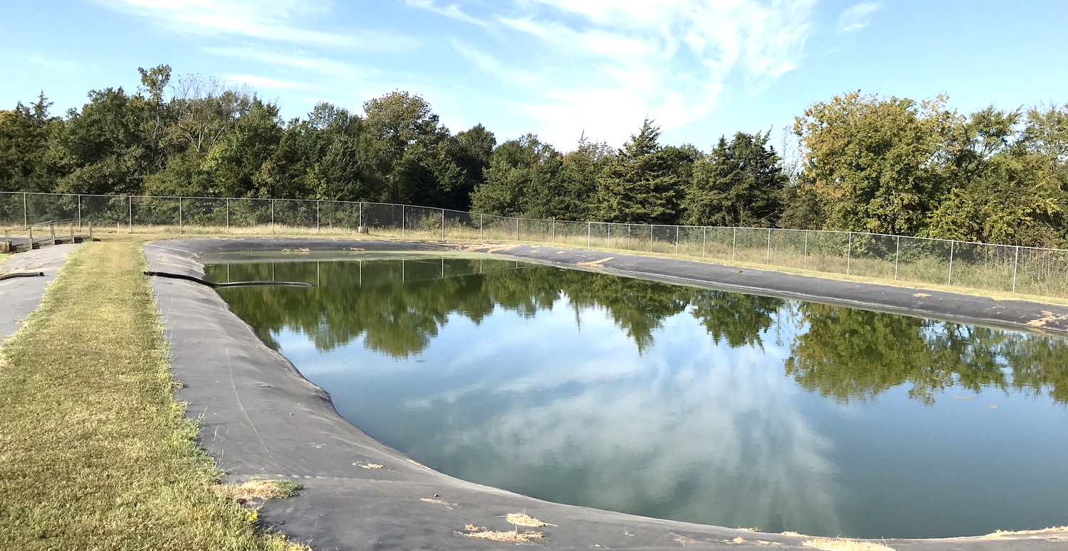
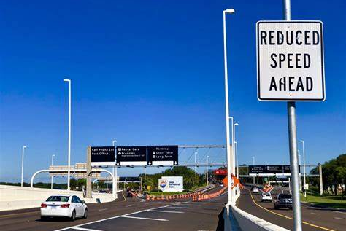
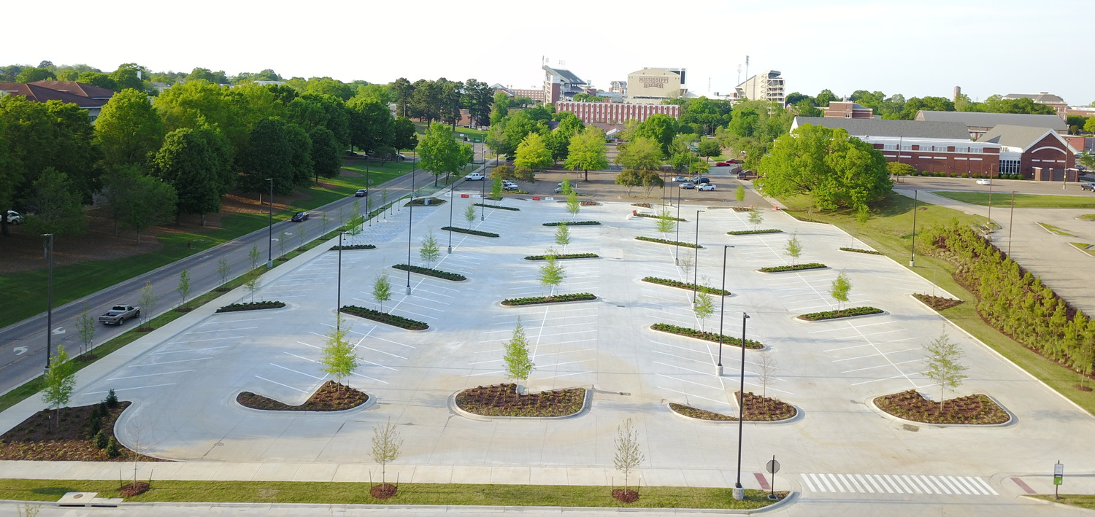
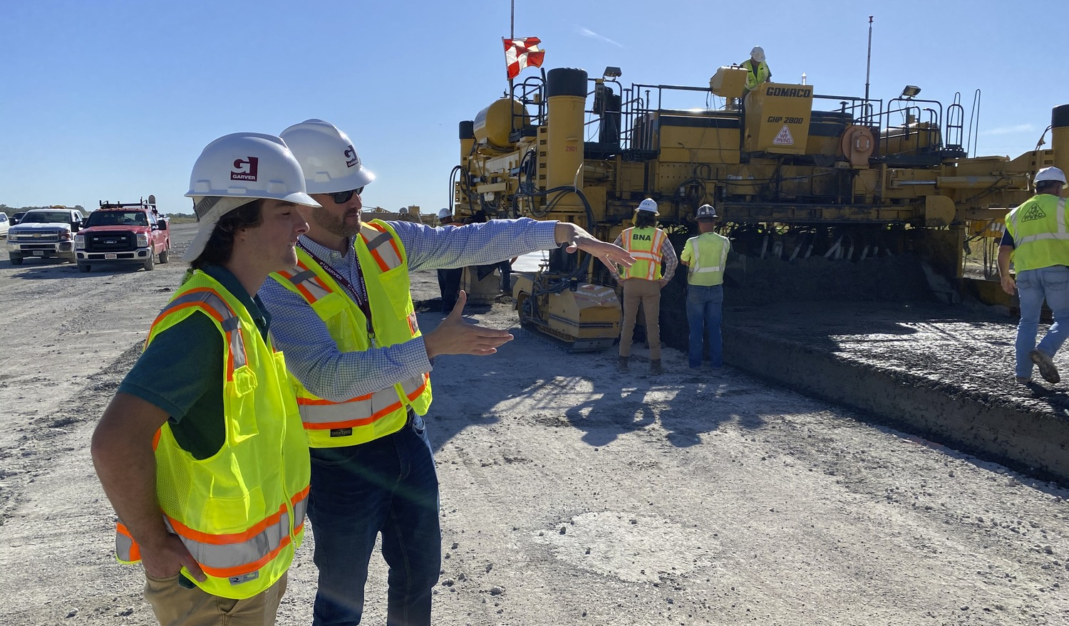
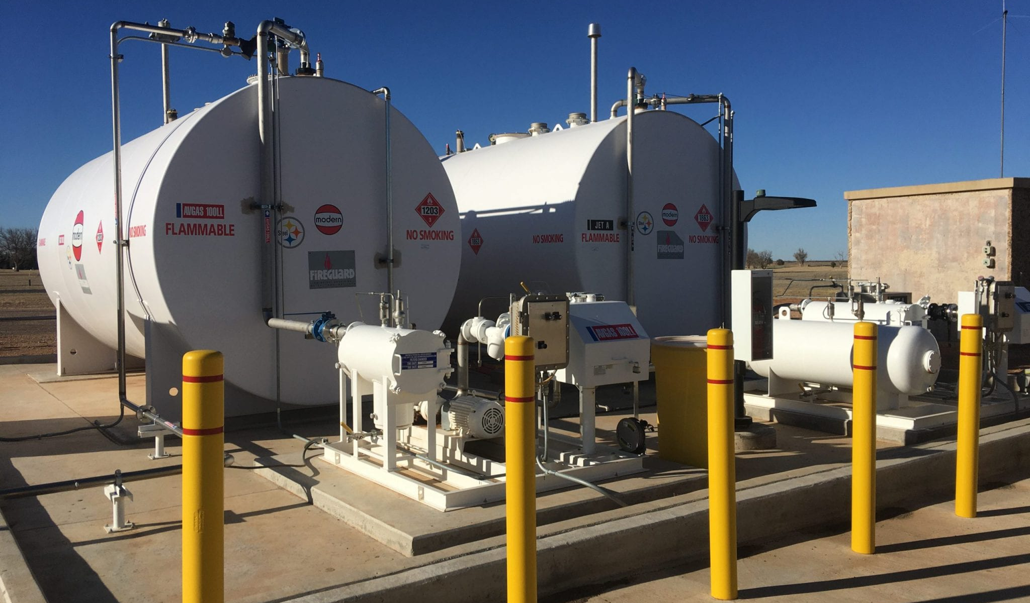
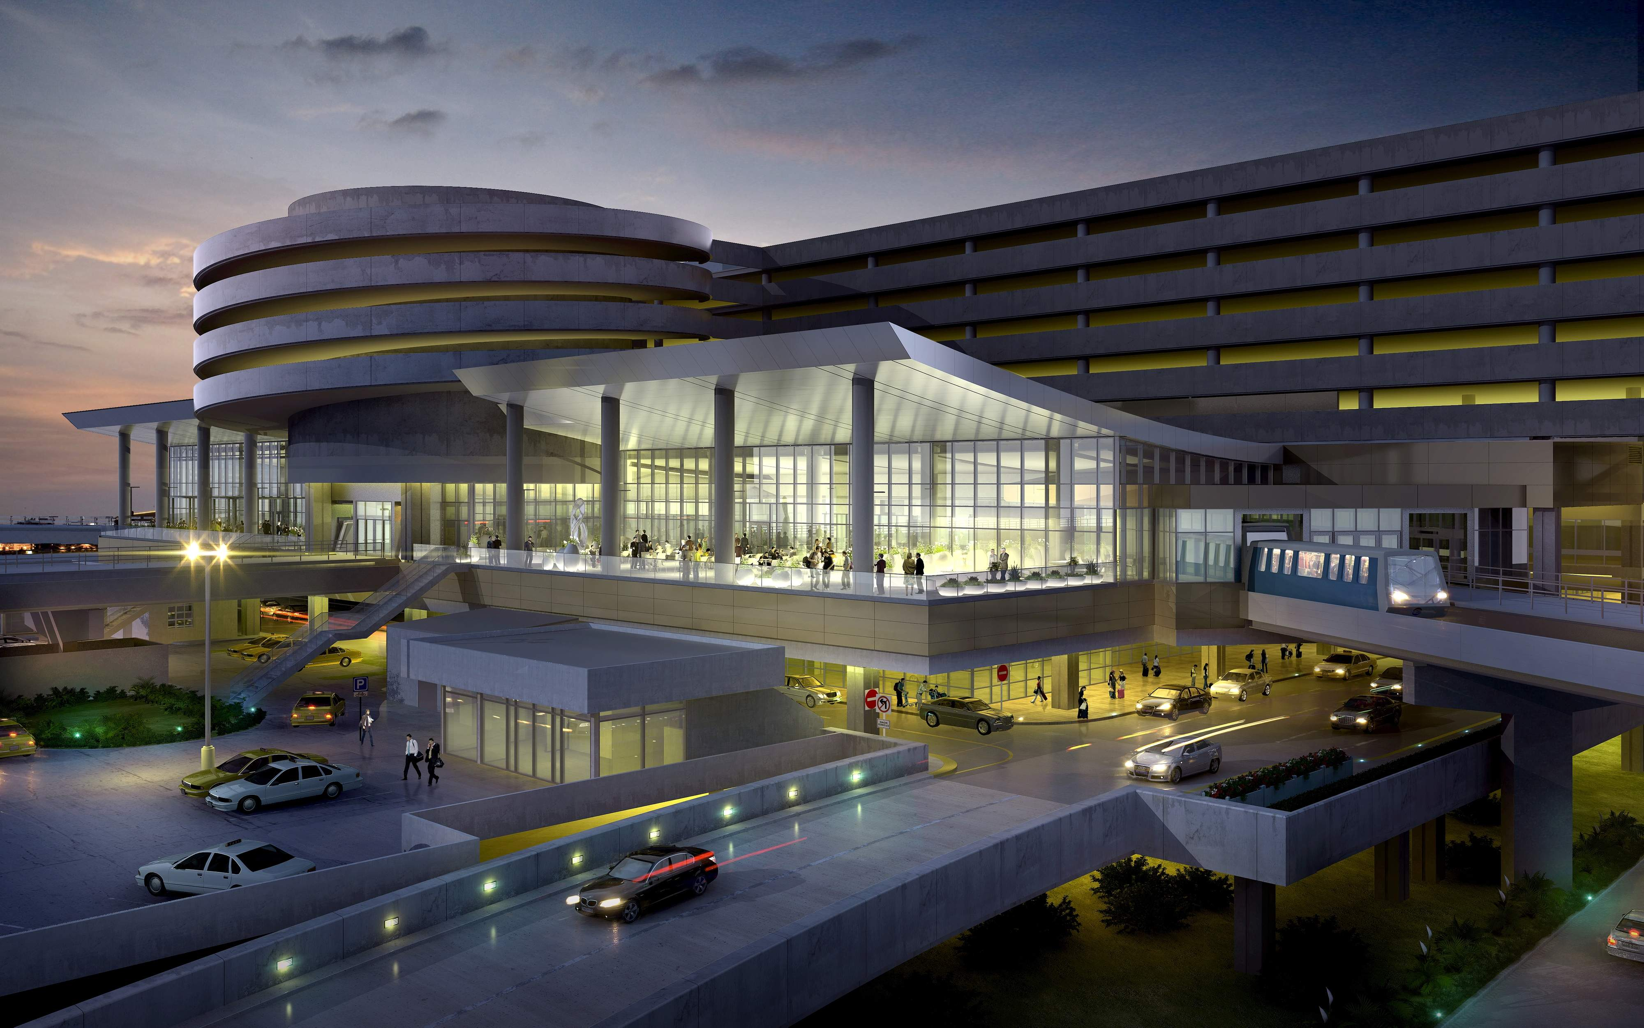
Airports Are Small Cities
AVIATION DESIGN
Bridges / Structural
Stormwater / Environmental
Airfields
Transportation
Site Development
Utilities
Buildings
Construction

Slide 5
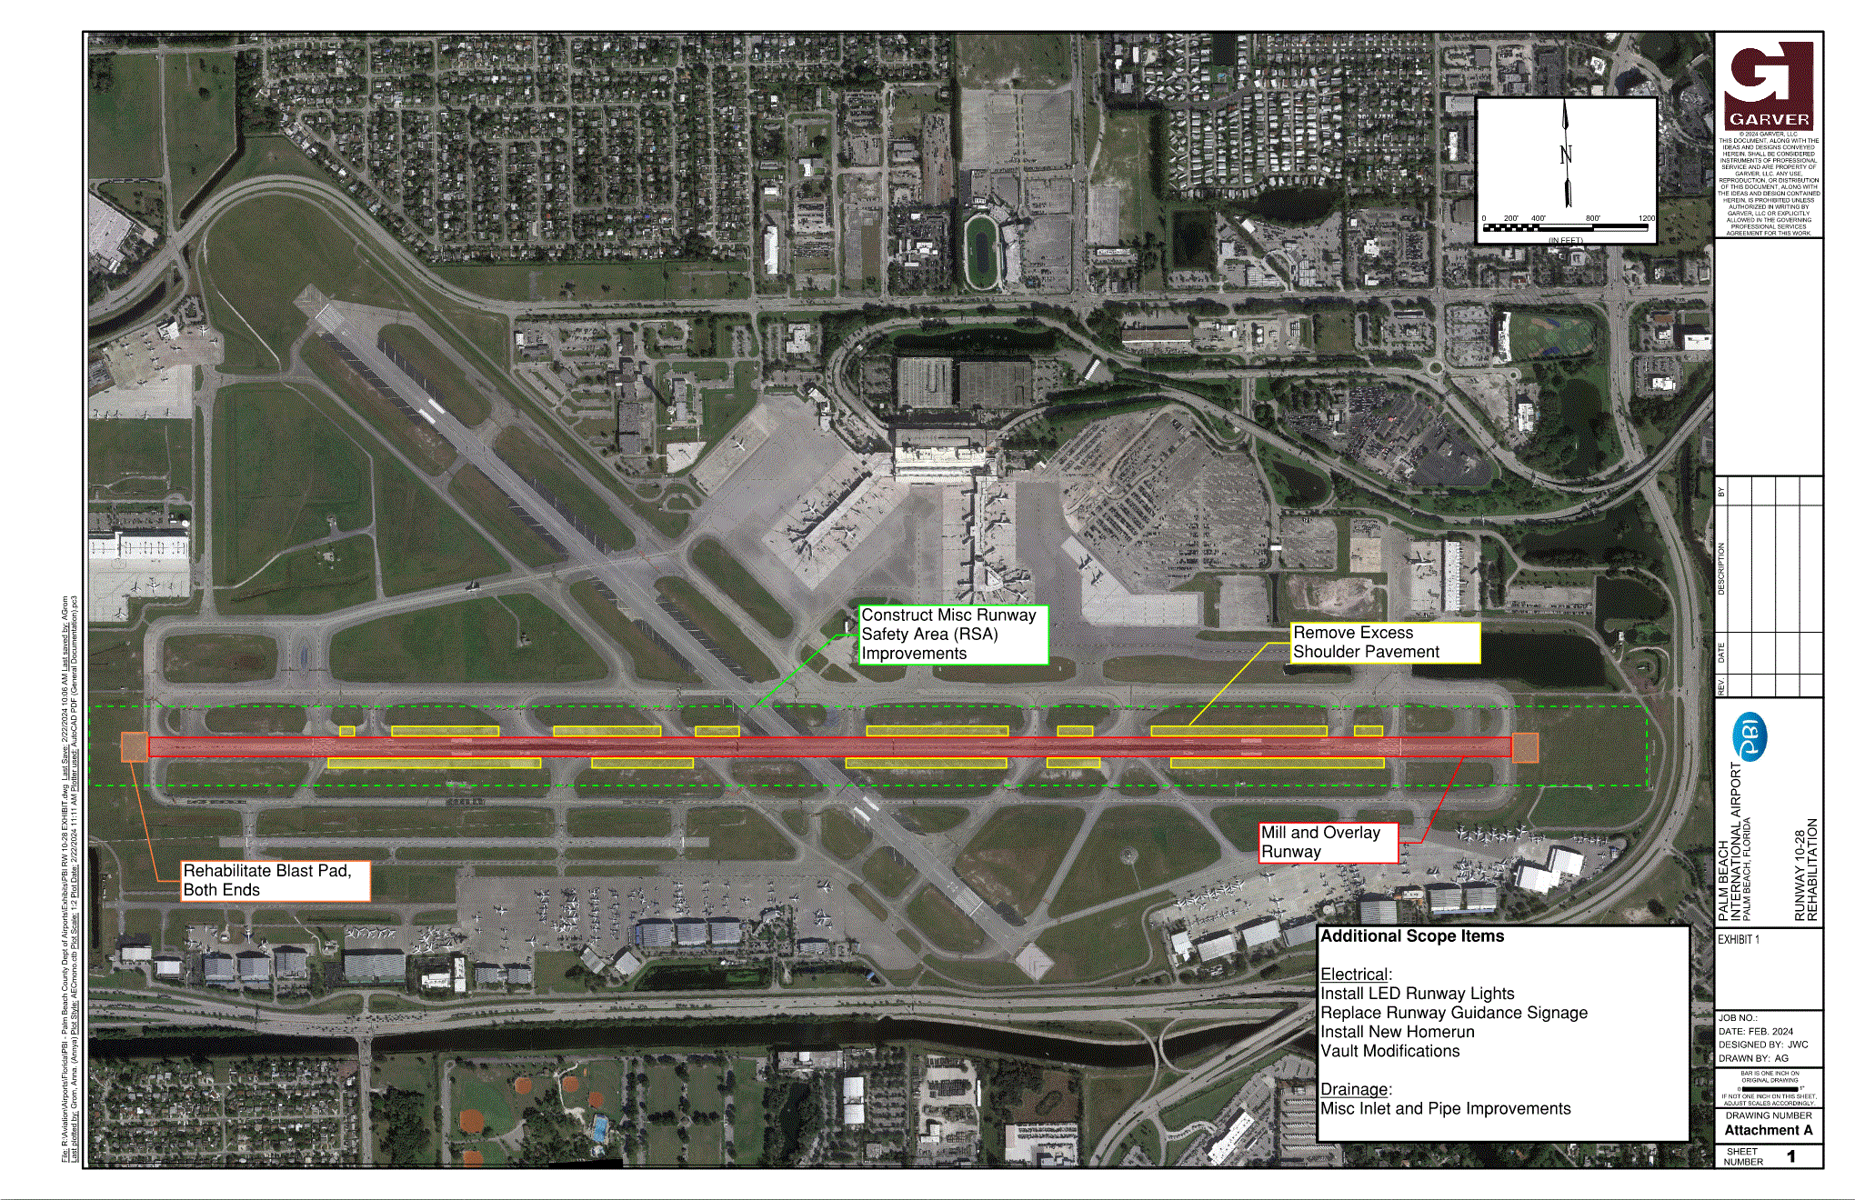
PBI Runway 10L-28R Rehabilitation
Aviation Design

Slide 6
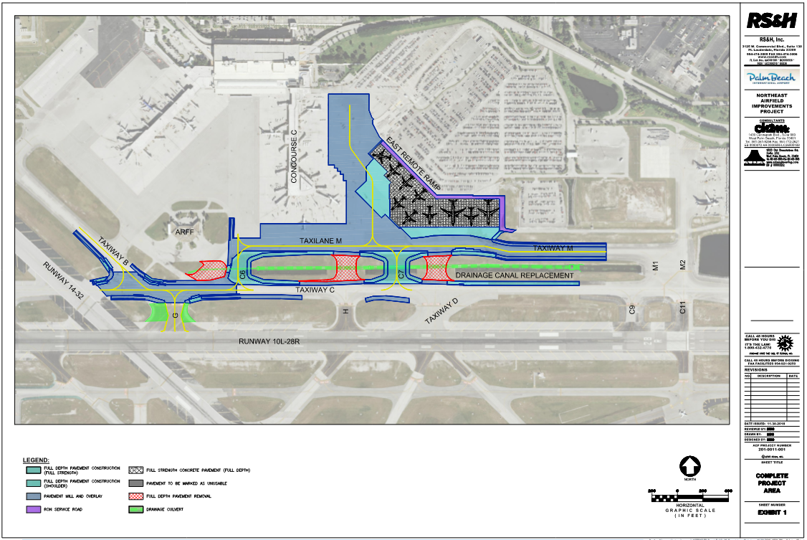
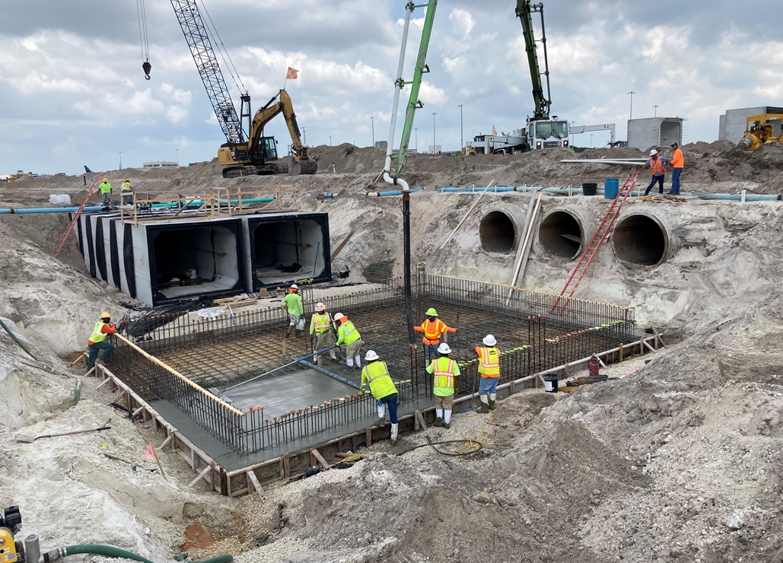
PBI Northeast Airfield Improvements Project
Aviation Design

Slide 7
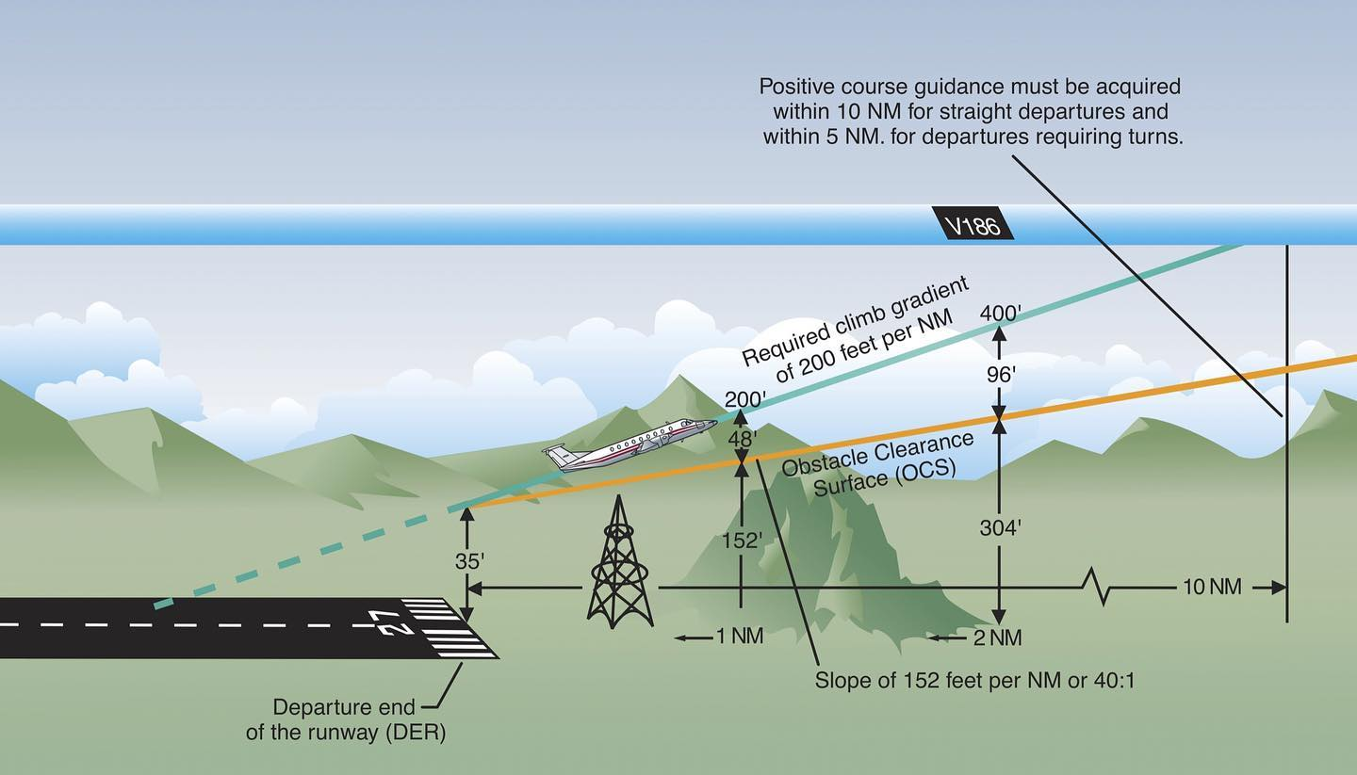
Airspace Analysis and Obstruction Evaluation
Aviation Planning

